Slide 1
Employee Attrition Using Logistic Regression

Slide 2

Employee Attrition
Employee attrition refers to the loss of employees through a number of circumstances, such as resignation and retirement or dismissal in company’s interest.

Slide 3
Contents
Machine Learning using python
Anaconda
Jupyter Notebook
Project Flow
Exploratory Data Analysis
Statistical model
Logistic Regression
Findings and suggestions

Slide 4
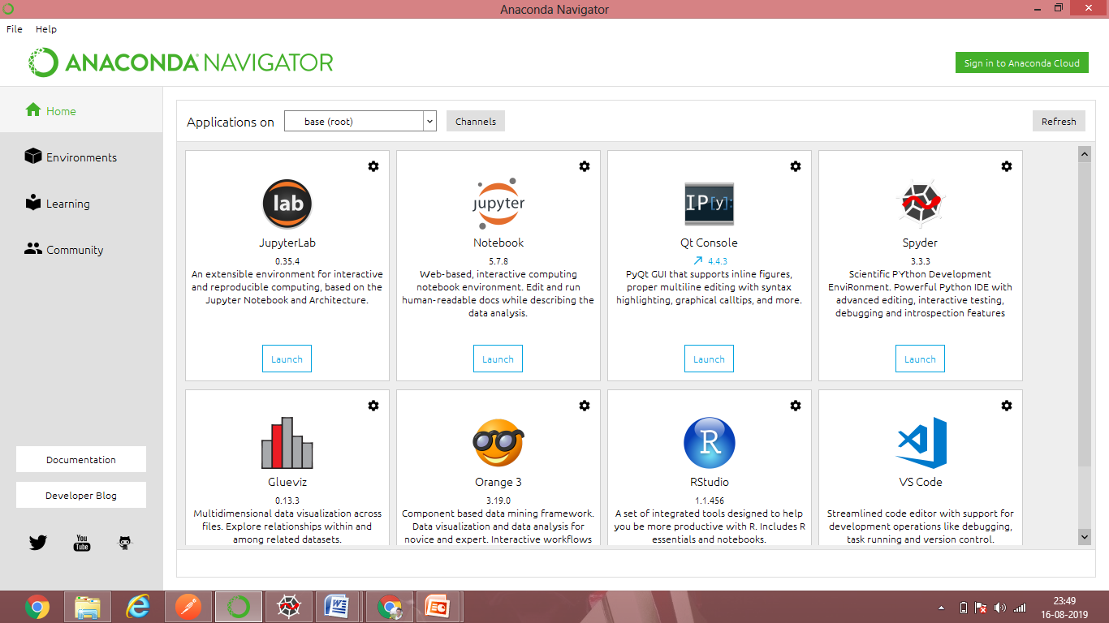
ANACONDA
Directly from the platform and without involving DevOps, data scientists can develop and deploy AI and machine learning models rapidly into production. Anaconda provides the tools needed to easily:
Collect data from files, databases, and data lakes.
Managing environment is easy because all package dependencies are taken care of at the time of download.
Share, collaborate on, and reproduce projects.

Slide 5
JUPYTER NOTEBOOK
It is a Notebook environment
Great for learning
A notebook integrates code and its output into a single document
Successor of Ipython notebook
Supports Special file formats that are not .py i.e, .ipynb
E.g. text file, csv file, notebook, terminal

Slide 6
Project Flow
1
2
3
EDA
Stat model
Logistic Regression
Importing the data into python and using various visualization techniques for understanding relations between various inputs and attrition
The stats model is a default statistical model used for preparing models . It first checks outputs and then works on inputs . We checked its parameters to advance and build models .
We prepare various Logistic Regression models inorder to compare them and select best suited model .

Slide 8

      STATISTICAL MODEL

Slide 9

NORMALIZATION
The normalization is done mainly to reduce the variance in data or any particular column .

Slide 10
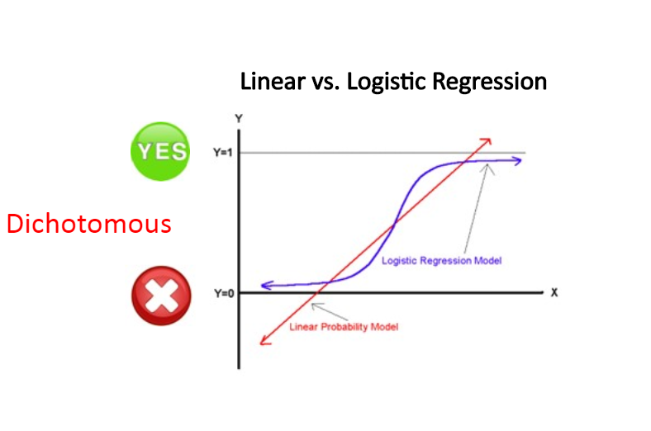
LOGISTIC REGRESSION
A special case of Linear Regression , when output is categorical we use LOGISTIC REGRESSION.
Logistic regression is used to describe data and to explain the relationship between one dependent binary variable or dichotomous and one or more numeric independent variables.

Slide 11
Best accuracy models
environment satisfaction ,job involvement, job satisfaction ,over time, stock option level ,total work years ,years in current role ,years with current manager.
86.84
Single Variant
Years in current role , test size = 0.3
86.73
Multi variant
Job Satisfaction , Over Time , Total Working Years , stock Option level , test size = 0.2

Slide 12
Accuracy values
86.84
1 input
Years in current Role
Test size =0.3
86.39
2 inputs
Total Working years , Years with current manager
Test size = 0.2
86.73
4 inputs
Job satisfaction ,Over time , total working years , stock option
Test size = 0.2
84.35
8 inputs
environment satisfaction ,job involvement, job satisfaction ,over time, stock option level ,total work years ,years in current role ,years with current manager.
Test size =0.3

Slide 14
Findings and suggestions
There are few unwanted or uninfluential columns present in the given data set
The over time and years in current role have played main role in effecting the
output .
The data looks noisy because of its outliers , non normal form and some statmodels
showing such differences.
Among all the crucial inputs we have chosen , most of them refer to a personal reasons
leading to attrition instead of performance levels or not working in company’s interests
We would like to suggest the company to look into it’s employee’s personal satisfaction
levels at workplace.
Because the loss of employee lead to loss of experienced workers and always training
new people is an additional cost , which company can work on.

Slide 15
THANK YOU
Any Questions?

